Slide 1

MATHS

Slide 2
TOPICS
ALGEBRA
LINEAR ALGEBRA
EQUATION OF LINE
MATRIX
SCALE VACTOR
OPERATIONS ON VECTOR
TRANSPOSE
COFFICIENT
WEIGHT ,BIAS
MATRIX ADDTION,SUB, MUL
MATRIX DOT PRODUCT

Slide 3
https://www.mathsisfun.com/algebra/introduction.html
https://www.mathsisfun.com/algebra/introduction-multiply.html
https://www.mathsisfun.com/algebra/equation-formula.html
https://www.mathsisfun.com/algebra/inequality.html
https://www.mathsisfun.com/algebra/inequality-solving.html
https://www.mathsisfun.com/algebra/definitions.html
https://www.mathsisfun.com/algebra/logarithms.html
https://www.mathsisfun.com/algebra/polynomials.html

Slide 4
https://www.mathsisfun.com/equation_of_line.html ***
https://www.mathsisfun.com/data/straight_line_graph.html
https://www.mathsisfun.com/data/cartesian-coordinates.html
Intercept (bias)
Cofficient (weight)
https://www.mathsisfun.com/algebra/quadratic-equation.html
https://www.mathsisfun.com/quadratic-equation-solver.html

Slide 5
Vector
https://www.mathsisfun.com/algebra/vectors.html
https://www.mathsisfun.com/algebra/vectors-dot-product.html
https://www.mathsisfun.com/algebra/vector-unit.html
https://www.mathsisfun.com/algebra/vectors-cross-product.html

Slide 6
Calculus
https://www.mathsisfun.com/calculus/index.html
https://www.mathsisfun.com/calculus/introduction.html
https://www.mathsisfun.com/calculus/derivatives-introduction.html *******
https://www.mathsisfun.com/calculus/derivative-plotter.html
https://www.mathsisfun.com/calculus/integration-introduction.html https://www.mathsisfun.com/calculus/differential-equations.html https://www.mathsisfun.com/algebra/functions-maxima-minima.html
https://www.mathsisfun.com/calculus/continuity.html

Slide 7
https://www.mathsisfun.com/gradient.html
https://www.mathsisfun.com/gradient.html
https://www.mathsisfun.com/y_intercept.html

Slide 8
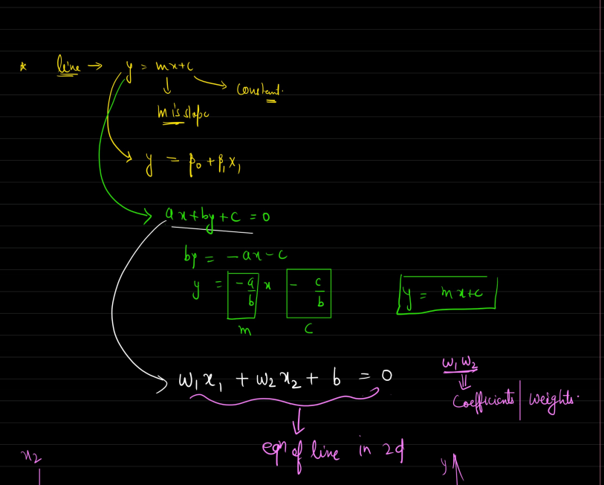
Equations of line
y-=mx+c
slope(gradient), coefficient
intercept
https://www.freecodecamp.org/news/how-machine-learning-leverages-linear-algebra-to-optimize-model-trainingwhy-you-should-learn-the-fundamentals-of-linear-algebra/ usecase ml

Slide 9
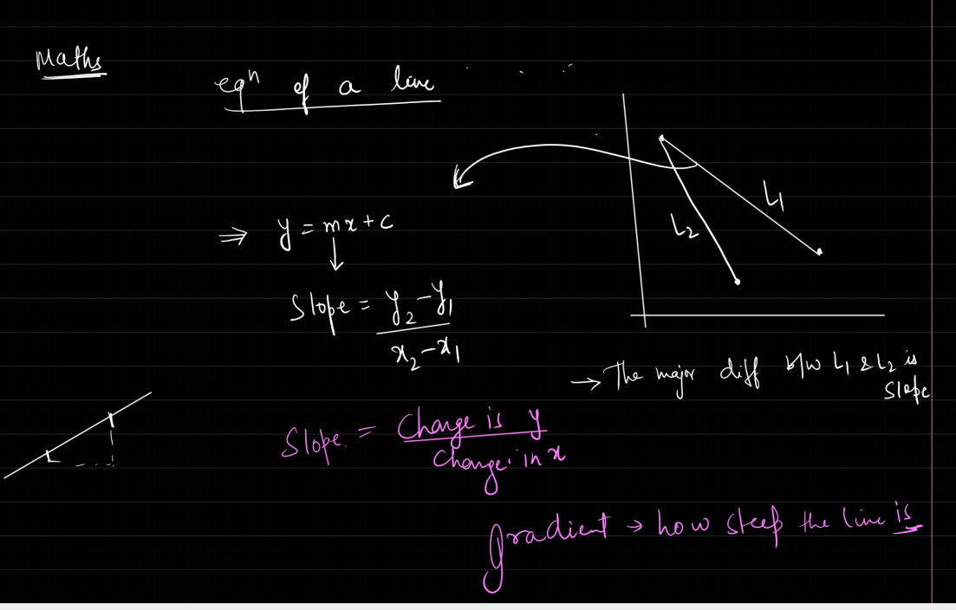
https://www.analyticsvidhya.com/blog/2022/06/linear-algebra-for-data-science-with-python/

Slide 10
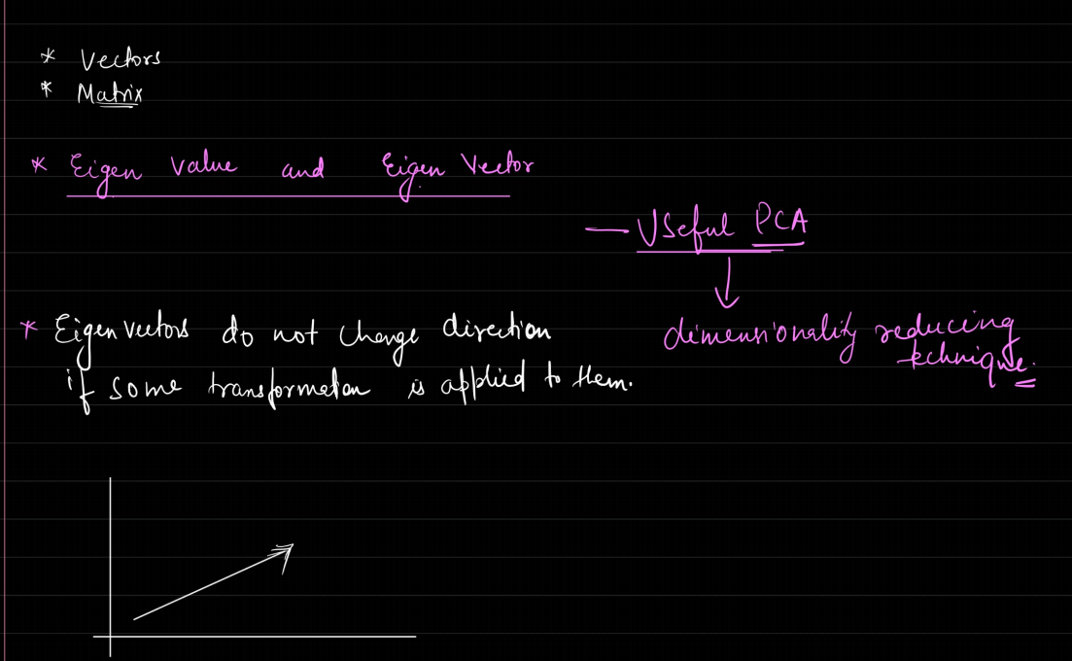

Slide 11
